Slide 1
DATA mining activities: Present and Future
Murilo Miranda Nüsslein
Data Science Team
Notes:
Good afternoon, I am Murilo Miranda and have been working in the data Science team of this company for 2 weeks.

Slide 2
Agenda
Projects
Investigate Customer Buying Patterns
Predicting Profitability
Data limitation
Project Proposals
Notes:
First I want to show you how my presentation is structured. The first two topics are the projects which I have worked up to now. So, I want to show shortly their results. First project was about investigating customer buying patterns and the second one was about predicting profitability. Then, I want to highlight some recommendations and discuss data limitation and how we could solve this problem. Finally, I have some project proposals.

Slide 3
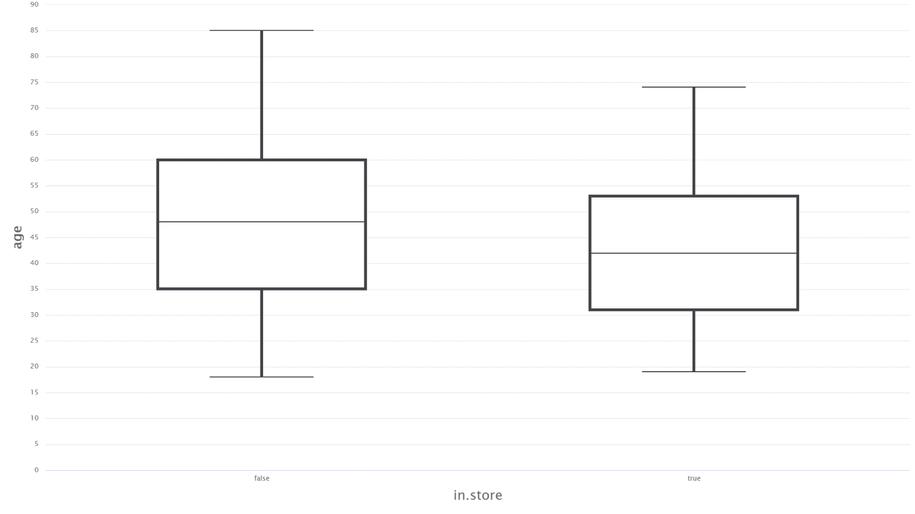
Investigate customer buying patterns
Age doesn’t tell the whole story
Age
Online
Store
Notes:
In the first project, the data showed that there is no difference in the ages of consumers who completed transactions online or in store, but we can see that consumers who used the online platform tended to be older.

Slide 4
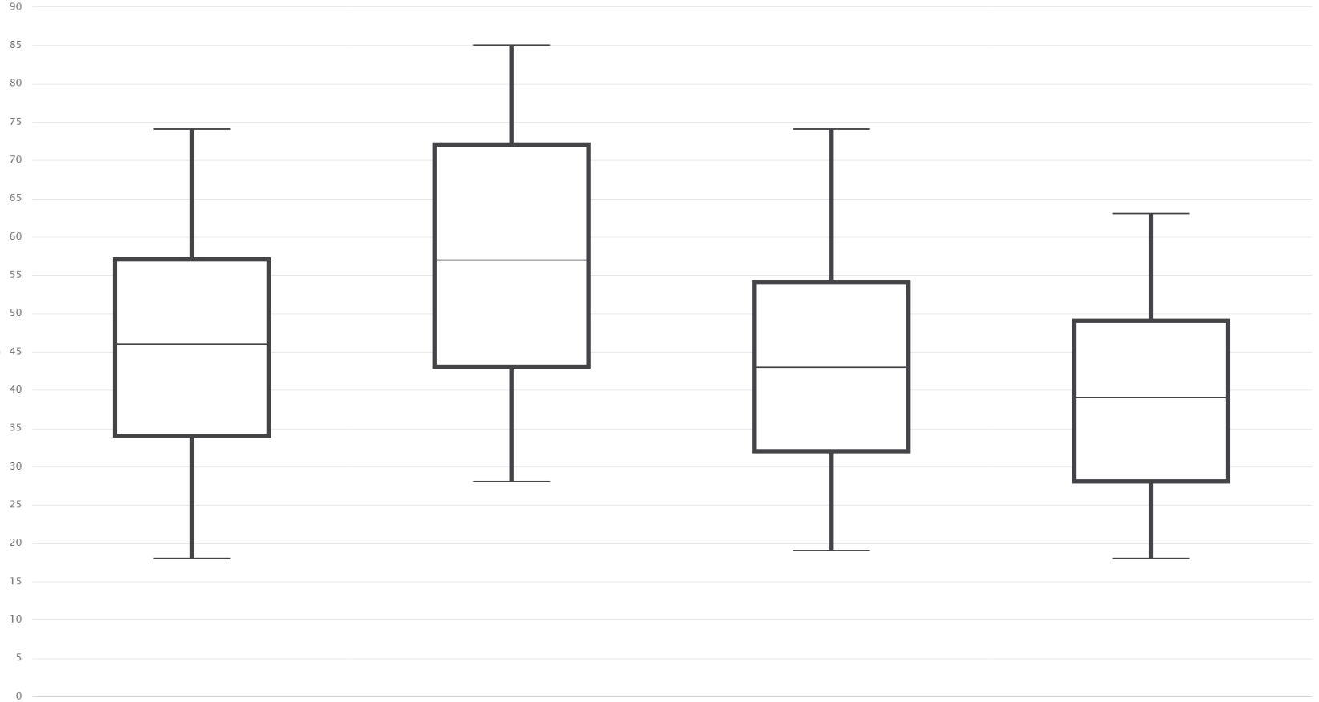
Lovely old West and charming young Central
Age
South
West
East
Central
Notes:
When we splitted the consumers into different regions, we saw that the West region there are older people than the central region where tend to be younger.

Slide 5
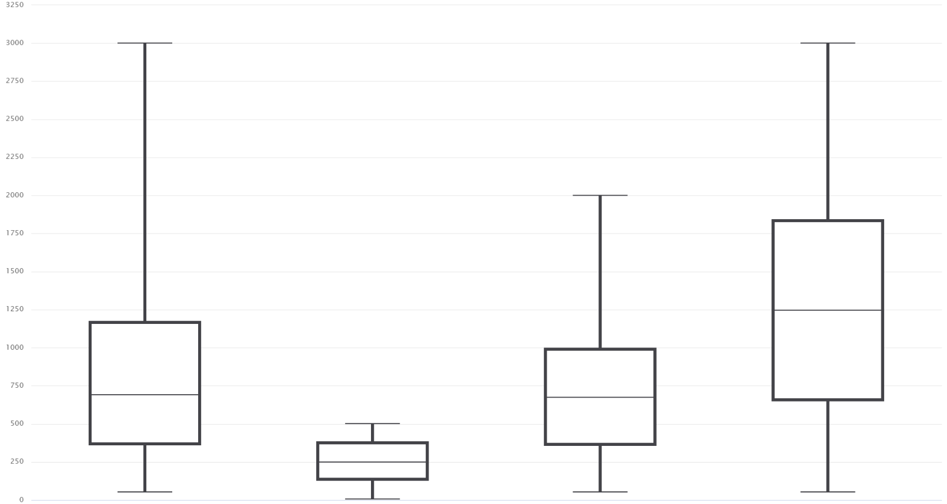
Let’s expand to West
Amount
South
West
East
Central
Notes:
And when we checked the amount they spent in these regions, the west spent less money than other regions.
A short conclusion for this project is: we need to think more about the west region and old people.

Slide 6
Predicting profitability
Product Diversification is the KEY
Product | Profit (SVM) | Profit (GBT) | Profit (kNN) | Average profit
Dell PC 172 | $125,876.06 | $446,790.12 | $141,900.00 | $238,188.73
Motorola Smartphone 196 | $73,407.32 | $99,727.90 | $108,619.50 | $93,918.24
Dell PC 171 | $30,414.36 | $163,809.98 | $67,191.38 | $87,138.57
Asus Netbook 181 | $25,546.03 | $114,338.09 | $36,314.08 | $58,732.73
Razer Laptop | $57,224.20 | $50,054.61 | $67,586.19 | $58,288.33
Notes:
In addition to this, we could offer new products such as PC’s and Laptops.
In the second project, our models showed that these five products will have the highest profitability, but we should also think about diversifying our product catalog.

Slide 7
RECAP
Expanding our business in the west region
Target audience: older people (>= 43 years)
Diversifying our product catalog:
Laptop (Razor, Asus and Apple)
PC (Dell model 171 and 172)
Tablet (Apple and Amazon)
Smartphone
Game Console
Notes:
All in all, we recommended expanding our business in the west region, as we did not get good economic results. Also we could provide offers to older people as a target audience.
However, we should be careful with the results because there were many missing information. In order to solve this problem, we should collect more data to better make predictions.

Slide 8






Would we like to grow like them?
Notes:
Like Amazon, Netflix, LinkedIn, and Facebook, they are examples of the effective use of predictive analytics. Amazon and Netflix have been around for about two decades; LinkedIn and Facebook for about a decade. Although they are relatively new in comparison to blue-chip like Walmart or IBM, they are some of the biggest companies in the world. The big reason: These companies have pioneered the use of predictive analytics in managing customer relationships and targeted marketing.
These companies are no longer just retail or service companies; they have transformed themselves into data companies. They used data wisely to grow their businesses. They collect, analyze, and monetize their data by using it to understand their customers’ needs. Without using data, these companies probably would not have grown as fast and as large as they have. So, would we like to grow like them? If so, I have some project proposals.

Slide 9
Project PROPOSALS
Predicting trends in sales:
Forecasting sales of a particular product
Forecasting the revenue contribution of a company division
Lead scoring (predicting the value of a sales lead)
Predicting trends in marketing:
Target marketing: Predicting which customers will respond to advertisement
Cross-selling: Predicting which products a customer will also be interested in.
Predicting which customers will leave the business relationship:
Predicting which customers will leave to a competitor
Predicting which customers will cancel a subscription
Prediction of fraud:
Predicting which retail transactions are likely to be fraudulent
Predicting unauthorized access to accounts

Slide 10
Thank you!
Any question?

